Slide 1
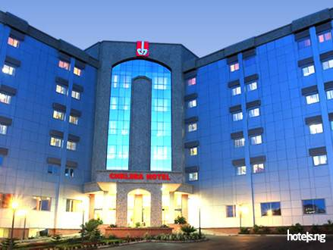
Chelsea Hotel Abuja, Nigeria is a multi-star best-in-class hospitality established on the 1st June, 2009, situated at Abuja, Nigeria. It contains 122 rooms with 8 different classes. It also offers many of the amenities and services.

Slide 2
Forecasting The Monthly Room Occupancy of Chelsea Hotel Using Autoregressive Integrated Moving Average (ARIMA)
12th February, 2023
Lilian Nwafor
Data Analyst

Slide 3
Data Exploratory process
Data Collection: The data was collected from Chelsea Hotel Abuja, Nigeria. Tools Used: R Programming Language with readr, dplyr , tseries, forecast libraries. Data Cleaning and Wrangling: The data collected was total daily occupancy from 2013 to 2021. then the data was merged into monthly data which resulted to 108 months. The datasets contained 108 rows and 2 columns, which are the date column and total occupancy column. The datatype was changed from “dataframe” to “ts” datatype for time series analysis.

Slide 4
Time series data analysis means analyzing the available sequential data to find out the pattern or trend and to predict some future values which will, in turn, be effective and optimize business decisions. The time series data is visualized and analyzed to find out mainly three things, trend, seasonality, and heteroscedasticity. Trend: It can be defined as the observation of increasing or decreasing pattern over a period. Seasonality: It refers to a cyclic happening of events. A pattern which repeats itself after a period. Heteroscedasticity: It is also known as level; it is defined as the non-constant variance from the mean calculated at different time periods. The property of having equal statistical variances. Few methods do not perform well in forecasting if the data is seasonal, and few do not perform well with trends in the data. Hence trends, seasonality and heteroscedasticity must be considered to select the best statistical method in forecasting.
A Snippet of Time Series

Slide 5
Autoregressive Integrated Moving Average (ARIMA) is a statistical analysis model that uses Time Series Data to predict future events where it assumes that the future outcome will be similar to the past events. The model can also be separated into these 3 parts : AR (Autoregression) : This is the lags of the differenced series. Model that regresses past time series to predict the present or future values of the series. Model that depends only on one lag in the past is called as AR model of order one. Autoregressive models are also known as long memory models as they must keep the memory of all the lags until its initial start point. AR(1) shows = the target = intercept = Coefficients = Lagged Target = error MA (Moving Average) : The moving average model forecasts a series based on the past error in the series called error lags.
ARIMA Model

Slide 6
I (Integrated) : The number of difference used to make the time series stationary. Also known as differencing, whereas It converts the non-stationary into a stationary time-series data. ARIMA model is generally denoted as ARIMA (p, d, q) and parameter p, d, q are defined as follow: p: the lag order or the number of time lag of autoregressive model AR(p) d: degree of differencing or the number of times the data have had subtracted with past value q: the order of moving average model MA(q)
ARIMA Model Continues

Slide 7
Visualize the time series: Plot the data and identify any unusual observations. Stationarize the time series: Stationarity alludes to an irregular process that creates a time-series which has mean, and distribution to be constant through time. The reason why we want it to be stationery is because it allows us to assume that past behavior will predict current behavior i.e knowing what happened in the past gives us a better idea of what will happen in the future. If the data are non-stationary, take first differences of the data until the data are stationary. (Differencing: is used to make trending and seasonal data stationary. Subtraction between current observation and previous observation is the process of differencing. It helps in making the mean constant) Plot ACF/PACF and find optimal parameters: Examine the ACF/PACF: Is an ARIMA(p,d,0) or ARIMA(0,d,q) model appropriate? Build the ARIMA model: Try your chosen model(s), and use the Akaike Information Criterion (AIC) to search for a better model. Check the residuals from your chosen model by plotting the ACF of the residuals, If they do not look like white noise, try a modified model. Make predictions: Once the residuals look like white noise, calculate forecasts.
ARIMA Modeling Process

Slide 8
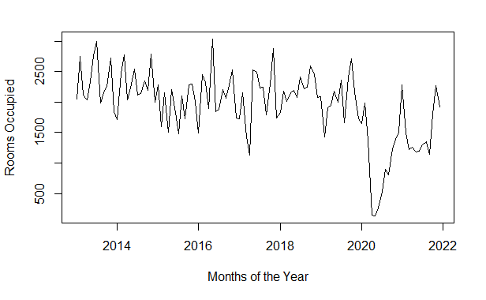
ARIMA Modeling Process Continues
Visualize the time series
The chart shows the data is not stationary. We also performed Argumented Dickey Fulller test to be sure of the stationarity, which shows that the p-value is greater than 0.05. So we take the log of the data to make it stationary
Augmented Dickey-Fuller Test
data: rm_ts
Dickey-Fuller = -3.224, Lag order = 4, p-value = 0.08751
alternative hypothesis: stationary

Slide 9
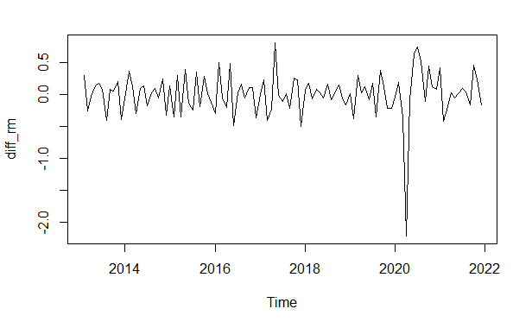
ARIMA Modeling Process Continues
Stationarize the time series:
Stationarity is a crucial aspect of a time series. A time series is determined to be stationary when its statistical properties such as the average (mean) and the variance do not alter over time. It has a constant variance and mean, and the covariance is separate from time.
Apart from viewing the chart to check for stationarity, we can also use Augmented Dickey Fuller Test to know the degree to which a null hypothesis can be rejected or fail to be rejected. It uses an autoregressive model and optimizes an information criterion cross multiple different lag values. ADF Test is a type of statistical test called Unit Root Test. The Unit Root Test determines how strongly a time series is defined by trend.
Augmented Dickey-Fuller Test
data: diff_rm
Dickey-Fuller = -5.1439, Lag order = 4, p-value = 0.01
alternative hypothesis: stationary
We take the log of the data to make it stationary. The result shows the p-value is 0.01 which is less than 0.05 threshold, so we reject the null hypothesis because the data is stationary.

Slide 10
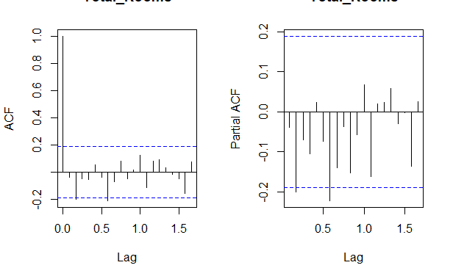
ARIMA Modeling Process Continues
Plot ACF/PACF and find optimal parameters: :
The chart shows that only few lags are outside the blue lines which shows that we can proceed with prediction

Slide 11
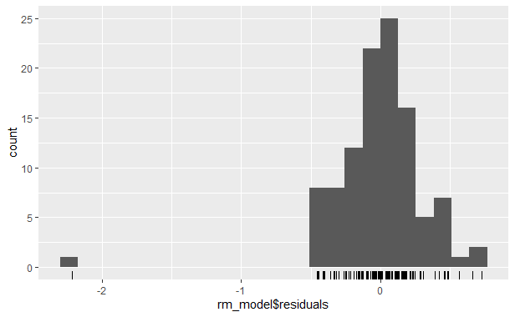
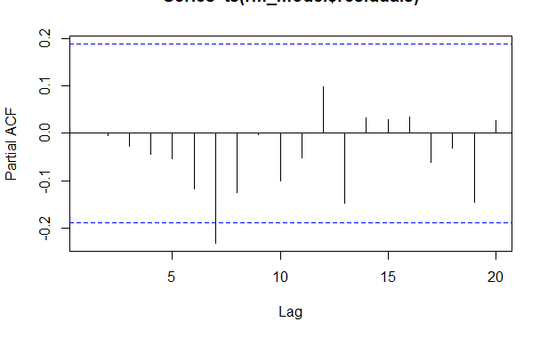
ARIMA Modeling Process Continues
Build the ARIMA model :
We build the ARIMA model using “auto ARIMA” function. This gave us the best ARIMA Model to be Best model: ARIMA(5,0,0) with minimum AKAIKE INFORMATION CRITERIA (AIC) value of 102.818
arima(x = diff_rm, order = c(5, 0, 0))
Coefficients:
ar1 ar2 ar3 ar4 ar5 intercept
-0.0647 -0.2220 -0.0706 -0.1004 0.0235 -0.0013
s.e. 0.0968 0.0963 0.0988 0.0963 0.0964 0.0224
sigma^2 estimated as 0.1086: log likelihood = -33.11, aic = 80.21
Checking model 5,0,0 gave us the intercept of 0.02 and AIC of 80.21. PACF residual shows a better chart with normal lags. The histogram shows, it is normally distributed

Slide 12
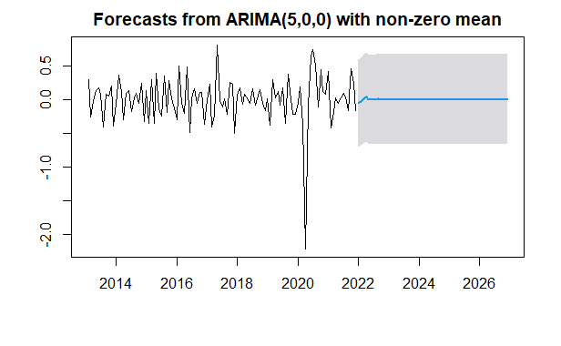
ARIMA Modeling Process Continues
Point Forecast <dbl> Lo 95<dbl> Hi 95 <dbl>
Jan 2022 -0.0566156289 -0.7024174 0.5891862
Feb 2022 -0.0272909160 -0.6744433 0.6198615
Mar 2022 0.0116801734 -0.6505816 0.6739420
Apr 2022 0.0296637649 -0.6331571 0.6924846
May 2022 -0.0026110141 -0.6660613 0.6608393
Jun 2022 -0.0076300357 -0.6721225 0.6568624
Jul 2022 -0.0046338777 -0.6693998 0.6601321
Aug 2022 -0.0023251391 -0.6671395 0.6624892
Sep 2022 0.0008769050 -0.6639500 0.6657038
Oct 2022 -0.0003083313 -0.6651456 0.6645289
Make prediction:
We forecasted to 2026 with 95% significant level at lover and upper bounds. the above chart shows the lower and higher limit confidence level around the grey area
To validate this forecasting we used the box test to confirm which shows normal p-value
Box-Ljung test
data: rm_forecast$resid
X-squared = 0.63624, df = 5, p-value = 0.9863
ME RMSE MAE MPE MAPE MASE
Training set 0.000238127 0.3294968 0.2148934 82.25436 117.6539 0.7085973
ACF1
Training set 0.0004163456
Accuracy Level

Slide 13
Challenges
The challenge encountered was getting the data as it is not a public data. It took a while to convince the management of Chelsea Hotel the purpose of my request and my intension.
Suggestion
Hoteliers should aim for high occupancy rates in order to get the most out of their structure and optimize revenue. Factors such as promotions and events, targeting the right markets and guest experience with a fair quality-price ratio.
Conclusion
The majority of researchers have conducted extensive research on forecasting room occupancy and attendance in hotels in various countries using various approaches. The rates are by definition noisy, non-stationary, and deterministically chaotic. Many economic, political, and psychological factors influence room occupancy and attendance rate in Hotels, some of these factors identified in this study include quality of effective service delivery, finance, competition, tourism and infrastructure. Forecasting room occupancy rates is not a simple task because of these unstable factors. Wrong adjustments which has an adverse effect on the decision making process.

Slide 14

Thank You

